Slide 1
Topic :Fault Identification In Seismic using Machine Learning

Slide 2
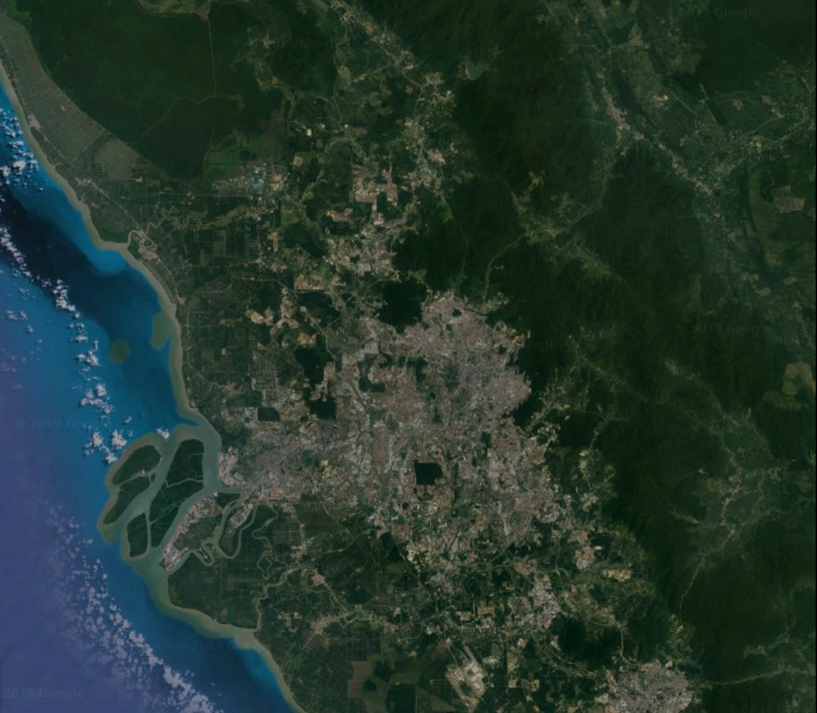
Significance of the Topic
Large size of seismic volumes. required longer time
Current algorithms need manual and repetitive effort

Slide 3
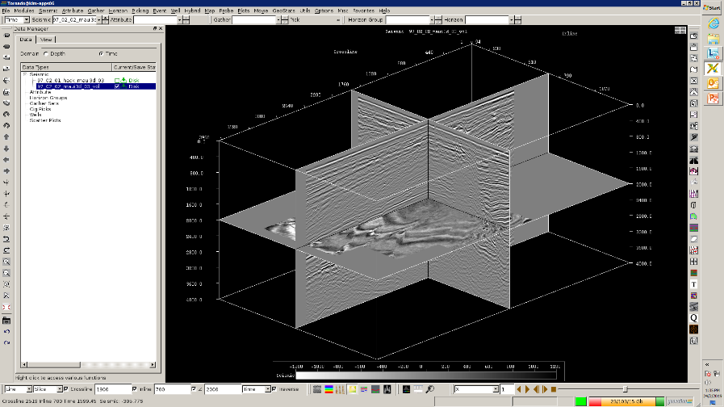





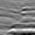

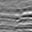
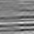







Fault detection in Seismic using Machine Learning
Sliding window of 40 x 40 sample size
1600 Input Unit
2 Hidden layers
3 Dimension (Crossline, Inline, Time)
Interpreted fault for 10 Inlines and 10 Crosslines
Original labeled samples =101 000
Synthetic samples =101 000
Total labeled samples = 202 000
80 % for training & 20 % for testing
400 Hidden Unit
200 Hidden Unit
2 Output Unit
FAULT
.
.
.
.
NO FAULT
Example of Fault Features in 40 x 40 size
Example of Non- Fault Features in 40 x 40 size
.
.
Deep Neural Network Framework used
***1 sample = 40 x 40 in
matrix

Slide 4
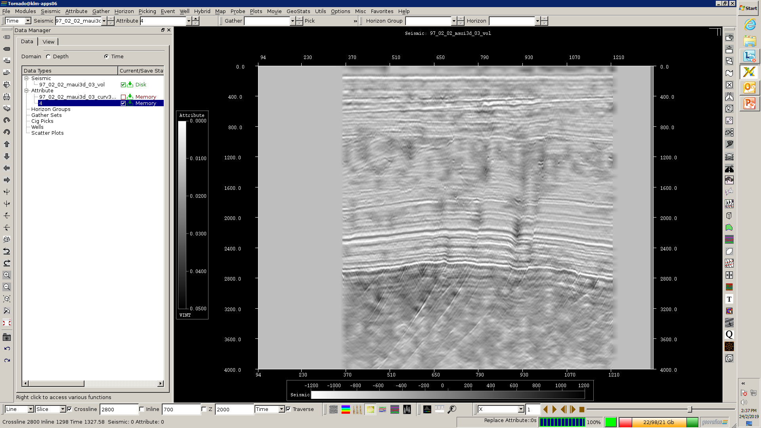
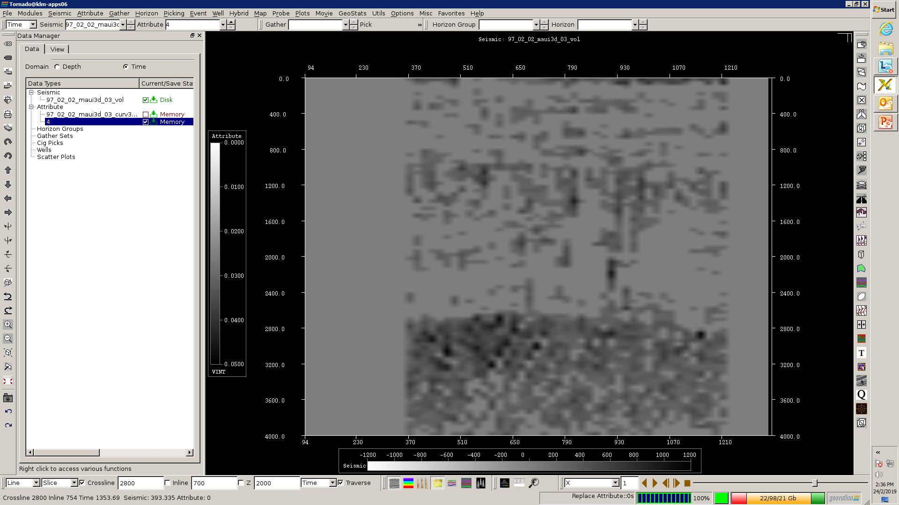
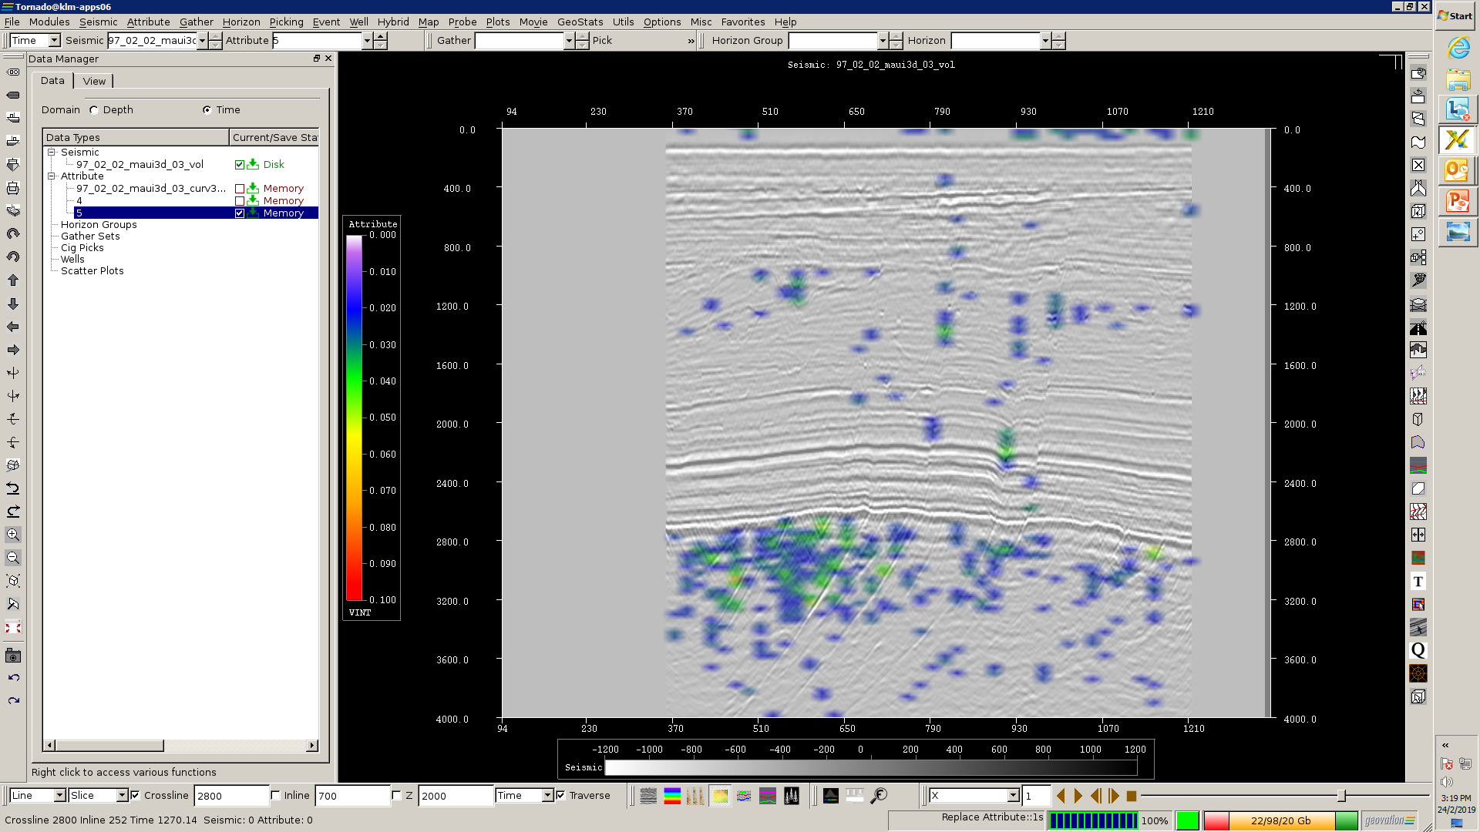
Results
Prediction of Crossline
Accuracy: 71 %
Cost Function : 0.102
Training Results
97 % Train
Accuracy
Cost Function
0.0301 Train
Running time =1 hour
Iterations

Slide 5
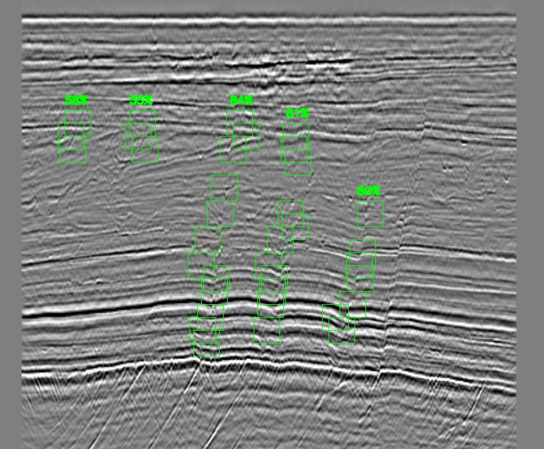
Results
Prediction of Crossline
Accuracy: 71 %
Cost Function : 0.102
Training Results
97 % Train
Accuracy
Cost Function
0.0301 Train
Running time =1 hour
Iterations

Slide 6

THANK YOU

